Slide 1


Geldium
AI-Powered Collections Strategy
Leveraging Agentic AI for Scalable, Fair, and Effective Debt Management at Geldium

Slide 2


Overview
How System Works
03
Role Of Agentic AI
04
Responsible AI Guardrails
05
Expected Business Impact
06

Slide 3

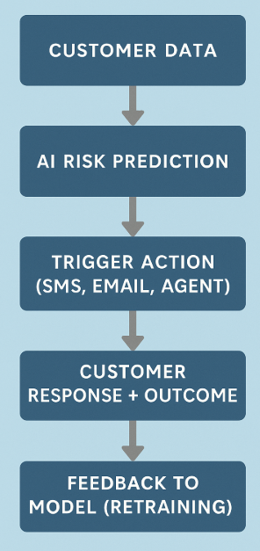
How the System Works
01
Input: Customer Data Ingestion
Age, Credit Utilization, Missed Payments, Account Tenure, etc.
02
Prediction Engine
Logistic regression model scores customers on delinquency risk
03
Automated Decision Logic
If risk > threshold, flag for action (outreach, reminder, support)
04
Action & Feedback Loop
Track repayment behavior → feed outcomes back into model to learn and adapt

Slide 4


ROLE OF AGENTIC AI
Autonomous Functions | Human Oversight Required
Risk scoring based on model | Reviewing edge cases or disputed scores
Triggering email/SMS reminders | Designing personalized intervention strategies
Segmenting high-risk customers | Auditing model bias and fairness
Logging repayment outcomes | Compliance reporting and threshold review

Slide 5





Responsible AI Guardrails
Human-in-the-Loop Audits
FAIRNESS MONITORING
Explainability
Compliance Checks
Human review of automated actions and feedback loops.
System aligns with lending regulations and customer data privacy standards.
Performance tested across employment, location, and tenure groups..
Logistic Regression used to ensure transparent risk scores.

Slide 6
Expected Business Impact
Personalized, fair interventions before default
Increased trust through transparent scoring
Faster resolution and repayment guidance
Customer Outcomes
Business KPIs
20%
30%
Reduction in delinquency among flagged customers
Increase in early collections due to preemptive outreach
Reduced manual review workload (automation of 60% of segmentation)

Slide 7






Geldium
THANK YOU!
BABAJAN M
Data Analyst
+91 9916828138
contactwithmbj@gmail.com
Bengaluru India.

